Slide 1
MINAT Lecture 5: Micro- and nanostructures in solar cells
Jessica de Wild (Jessica.dewild@uhassselt.be)

Slide 2
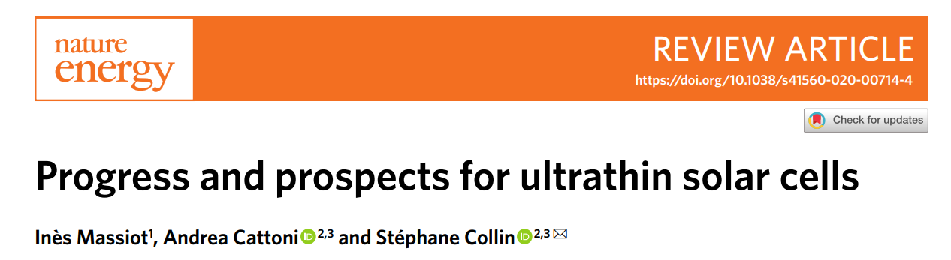

Slide 3
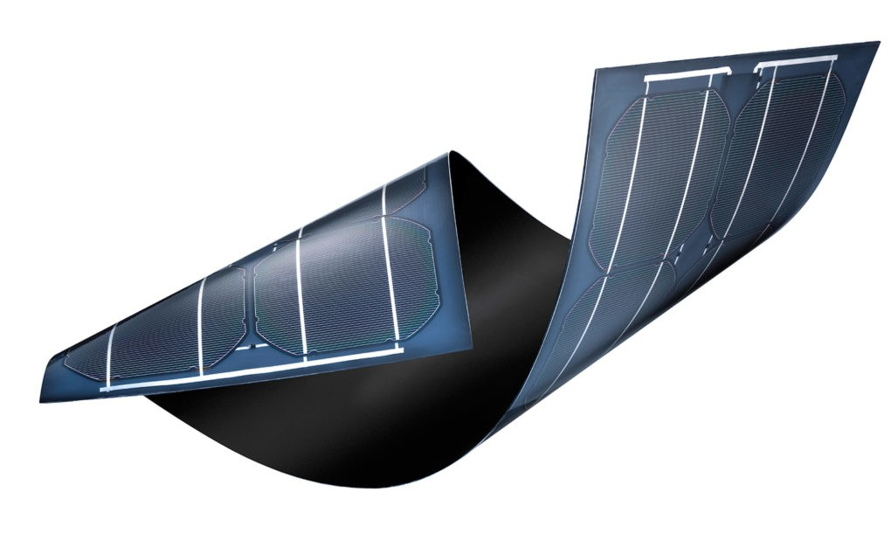
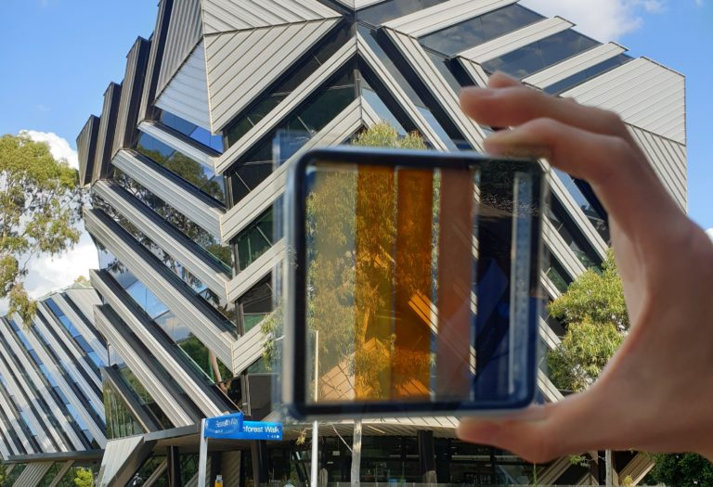
Why ultrathin solar cells?
Less materials use
200 µm → ~ µm absorber layer thickness
Reducing processing costs and time
Options for making them flexible or semi-transparent

Slide 4
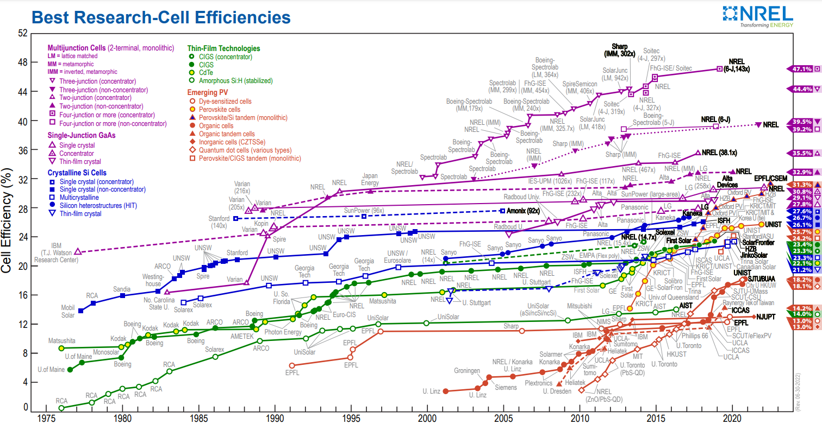
Why ultrathin solar cells?
But: often less efficient or more expensive than Si
https://www.nrel.gov/pv/interactive-cell-efficiency.html

Slide 5
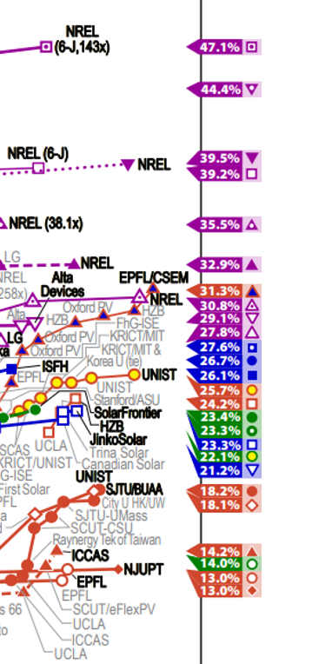
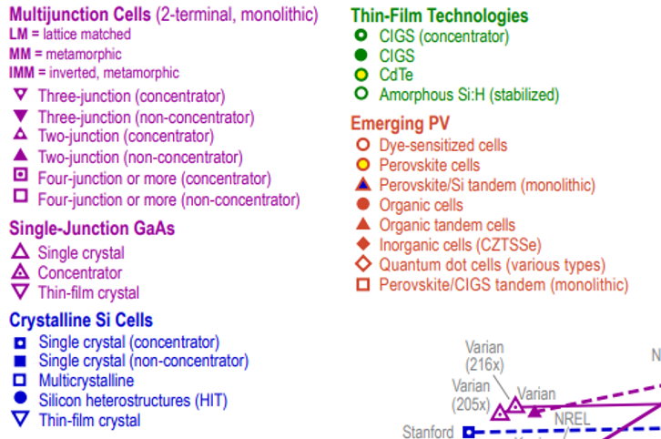

Slide 6
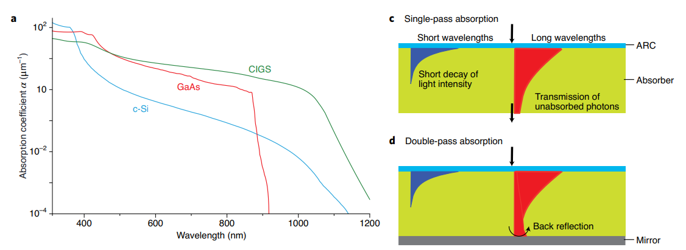
Challenges in ultrathin PV
Light absorption limited by absorber layer thickness
Recombination of charges is higher at the contacts

Slide 7
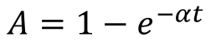
Absorption
How much light is absorbed, depends on the thickness of the layer
For CIGS:
2 µm

Slide 8
Absorption
How much light is absorbed, depends on the thickness of the layer
For CIGS:
500 nm

Slide 9
Challenges in ultrathin PV
Light absorption limited by absorber layer thickness

Slide 10
Absorption
Back reflector: gives unabsorbed light a second change to be absorbed (double pass absorption)
500 nm
Back reflector

Slide 11
Light management
Light scattering: increasing path length
Meer licht wordt geabsorbeerd

Slide 12
Light management
Light scattering and back reflection: further increasing path length

Slide 13
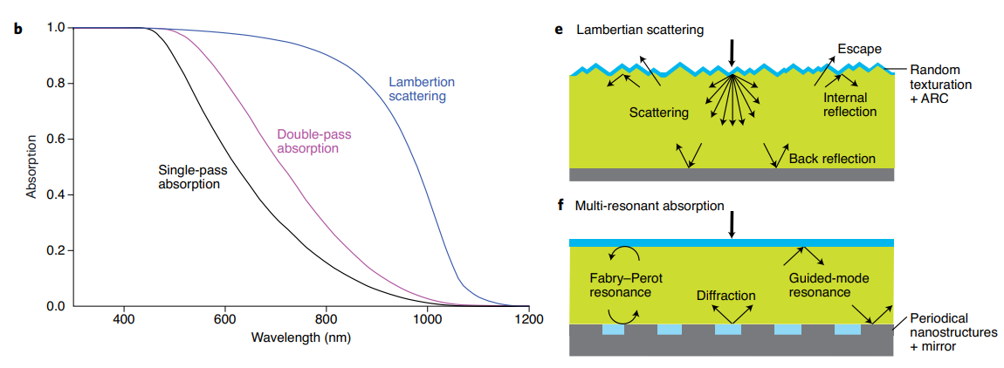
Absorption
Percentage absorbed light in 2 µm thin Si absorber layer

Slide 14
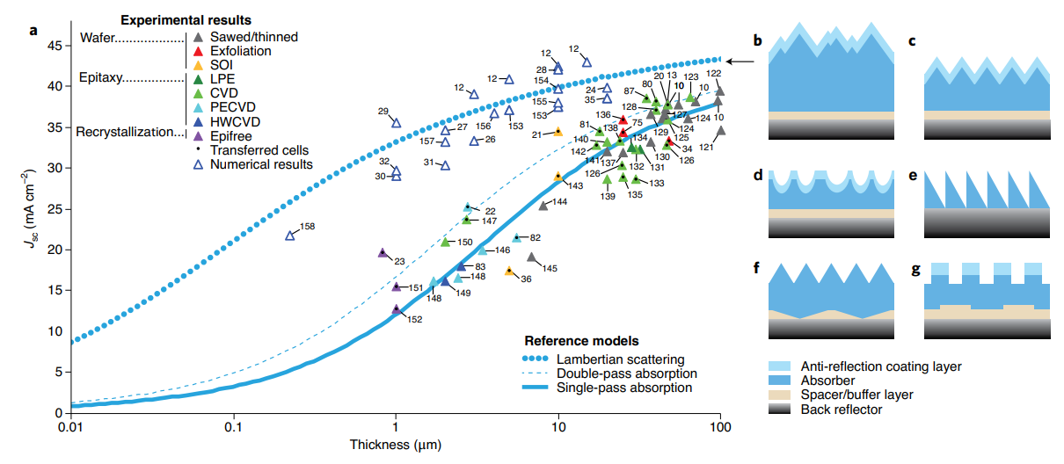
State-of-the-art of ultrathin Si solar cells
Current generation of ultrathin Si absorber layers

Slide 15
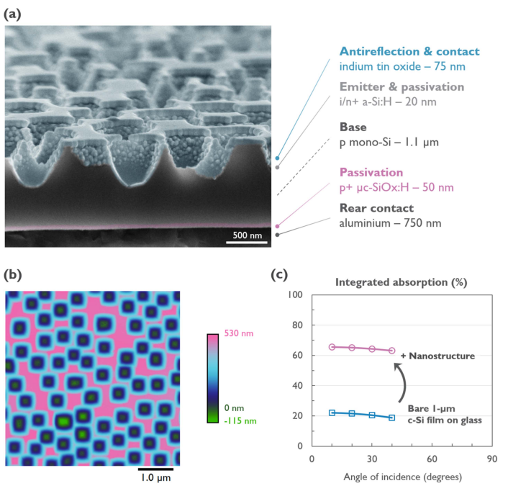
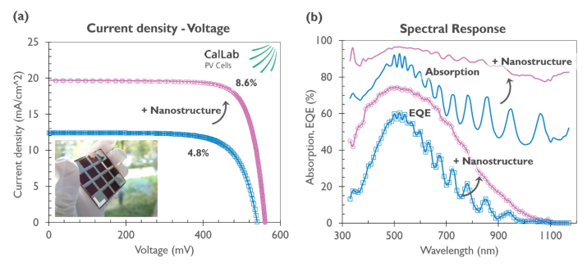
State-of-the-art of ultrathin Si solar cells
Current generation of ultrathin Si absorber layers (ref 23)

Slide 16
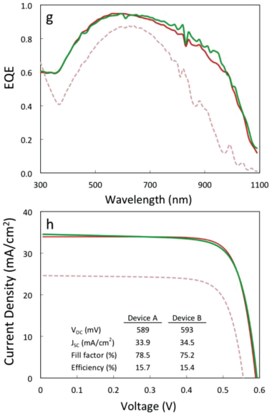
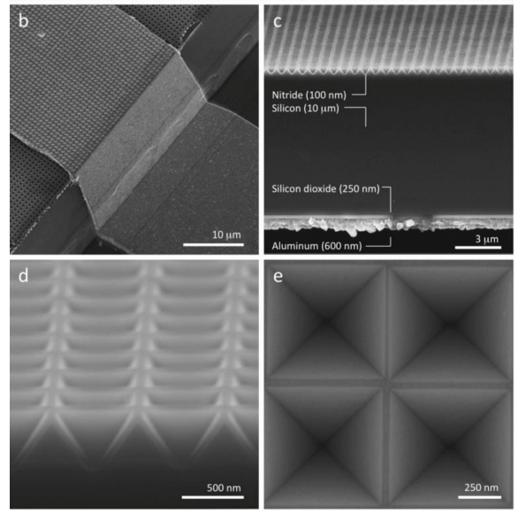
State-of-the-art of ultrathin Si solar cells
Current generation of ultrathin Si absorber layers (ref 21)

Slide 17
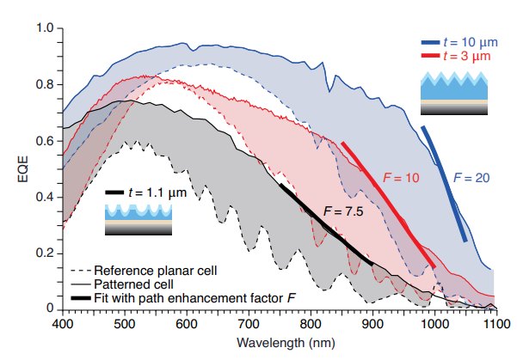
Light trapping
EQE spectra of cells with (solid curve) and without (dashed line) light trapping for difference thicknesses absorber layer
F: light trapping factor
Double pass: F = 2
Lambertian scattering:
F = 4n²
(n = refractive index)

Slide 18
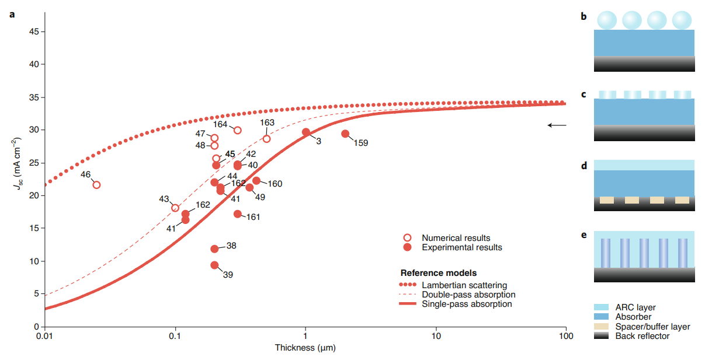
State-of-the-art of ultrathin GaAs solar cells
Current generation of ultrathin GaAs absorber layers

Slide 19
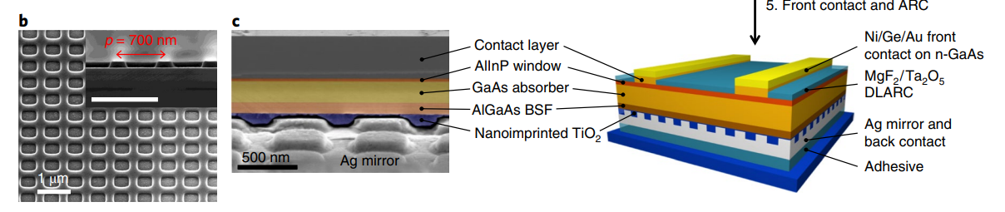
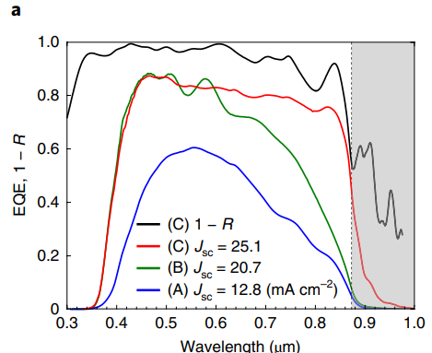
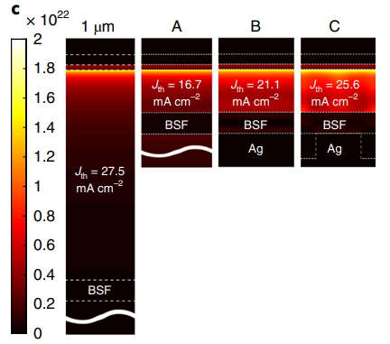
State-of-the-art of ultrathin GaAs solar cells
Current generation of ultrathin GaAs absorber layers

Slide 20
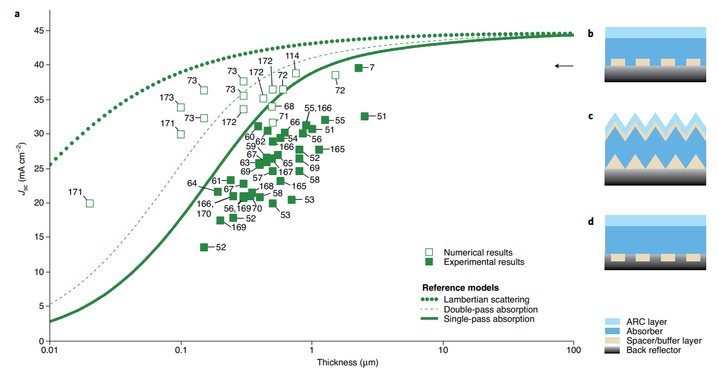
State-of-the-art of ultrathin CIGS solar cells
Current generation of ultrathin CIGSe absorber layers

Slide 21
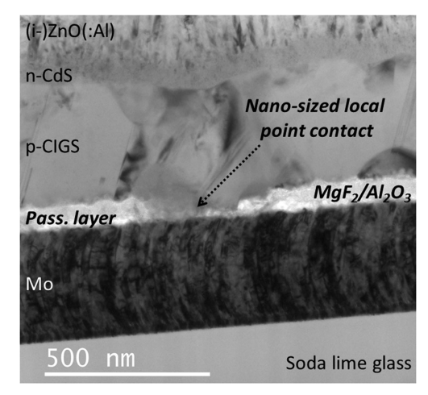
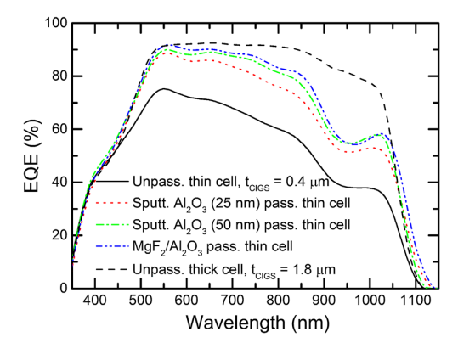
State-of-the-art of ultrathin CIGS solar cells
Current generation of ultrathin CIGSe absorber layers

Slide 22
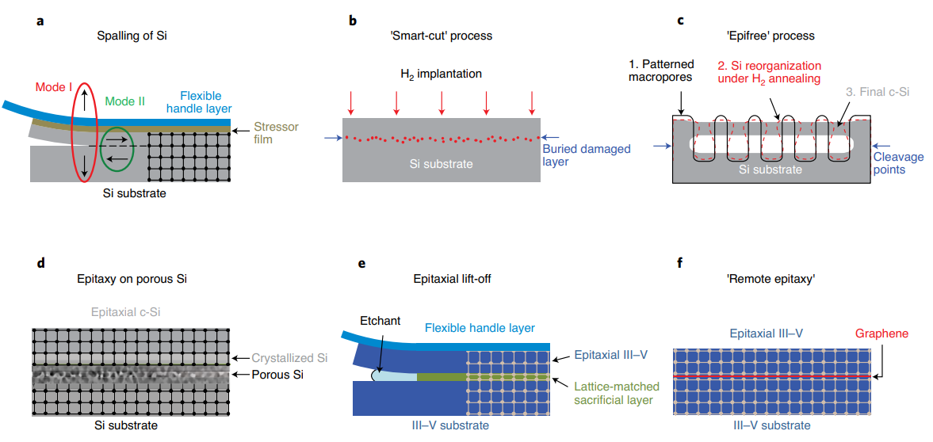
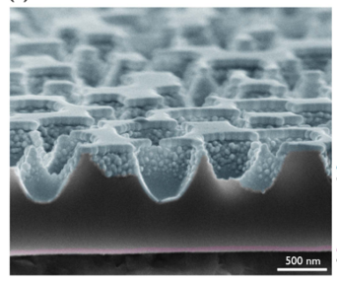
Transfer techniques of thin films
Thin film transfer to reflective substrates
ref 23

Slide 23
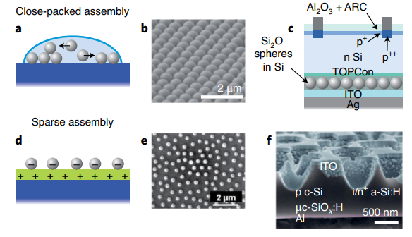
Fabrication of nanostructures I
Nanosphere lithography
Sub micron structures for light scattering
Self assembled micro/nano spheres deposited on surface
Spheres are used as lithograph mask or embedded in the solar cells
Notes:
However, their cost and long exposure time limit their use to proof-of-concept devices on small areas. In the framework of solar cell fabrication, specific techniques are required to structure matter at the nanoscale while being low-cost, scalable (patterned area >15 x 15 cm2 ) and versatile

Slide 24
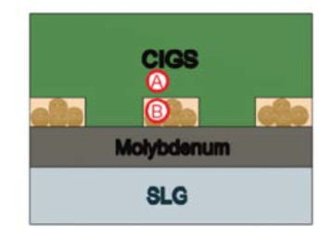
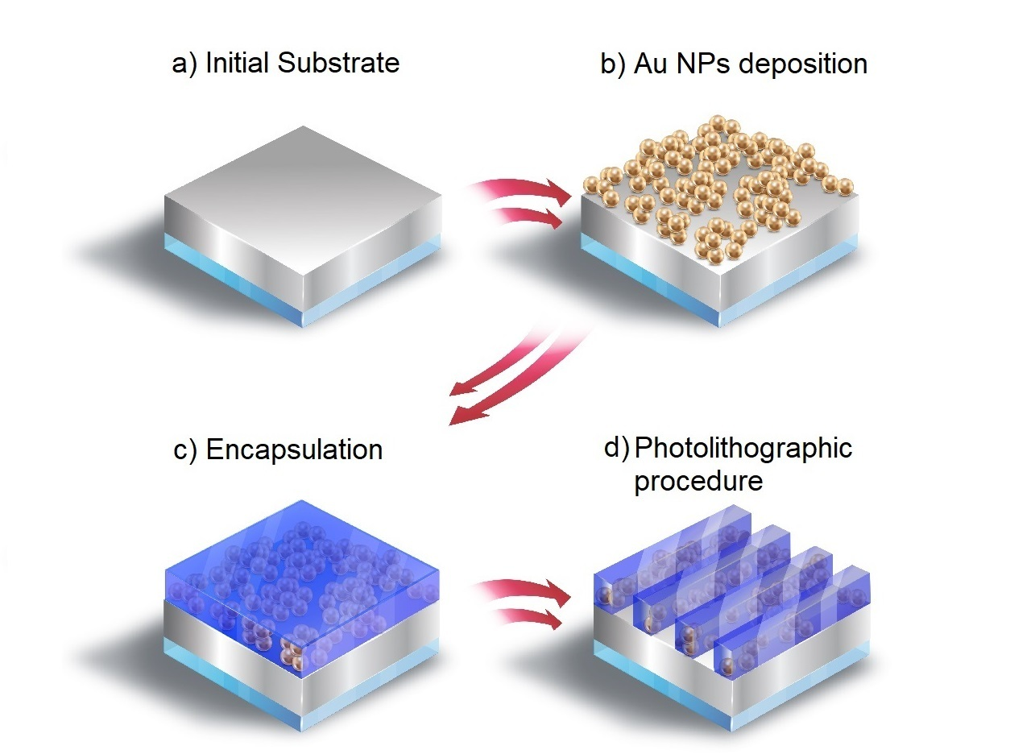
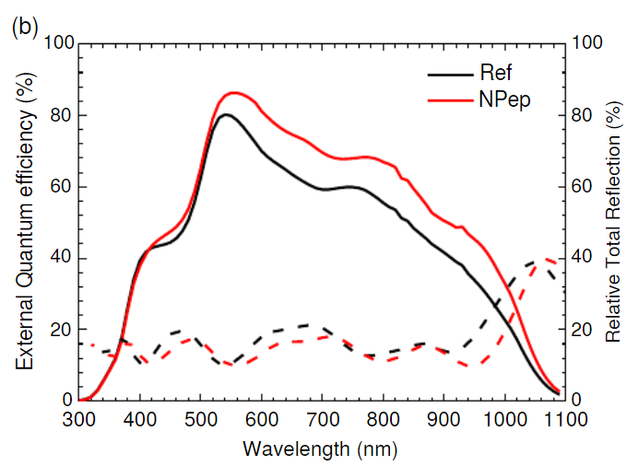
Fabrication of nanostructures I
Nanosphere lithography
Sub micron structures for light scattering
Notes:
However, their cost and long exposure time limit their use to proof-of-concept devices on small areas. In the framework of solar cell fabrication, specific techniques are required to structure matter at the nanoscale while being low-cost, scalable (patterned area >15 x 15 cm2 ) and versatile

Slide 25
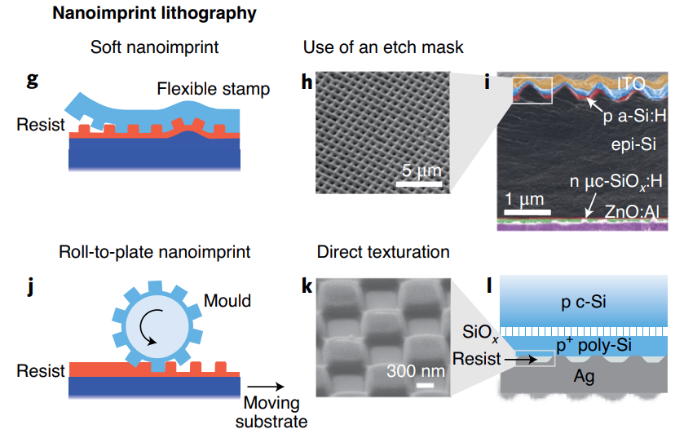
Fabrication of nanostructures II
Nanoimprint lithography
Sub micron structures for light scattering
Replicating micro or nanoscale pattern by stamping in a soft resist materials
Stamp often made using an expensive master molt containing the structures

Slide 26
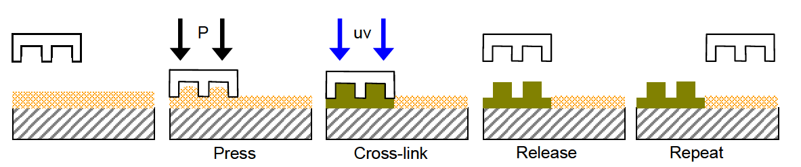
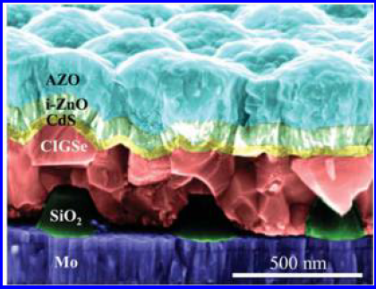
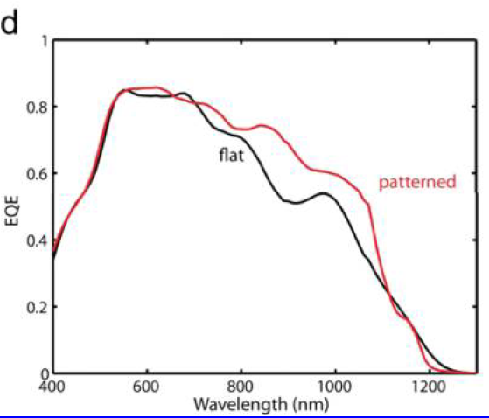
Fabrication of nanostructures II
Nanoimprint lithography
Sub micron structures for light scattering

Slide 27
Selective contacts
Vacuum level
Conduction band
Conduction band
Conduction band
Energy (eV)
Valence band
Valence band
Valence band
Insulator
Semiconductor
Conductor

Slide 28
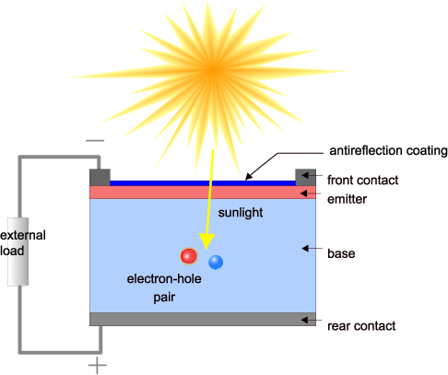

Selective contacts
When photon is absorbed, a hole (h) is left behind in the valence band and electron (e) is added in the conduction band → # of e = # of h
Conduction band
$$γ_{eV}$$
Valence band

Slide 29
Selective contacts
2. → # of e = # of h, e-h pairs will be separated due to internal electric field
Conduction band
Electron contact
Valence band
Hole contact

Slide 30
Selective contacts
3. → e and h need to be collected at the contacts
Conduction band
Electron contact
Valence band
Good contacts
Hole contact

Slide 31
Selective contacts
3. → e and h need to be collected at the contacts
Conduction band
Electron contact
Valence band
Bad contacts
Hole contact

Slide 32
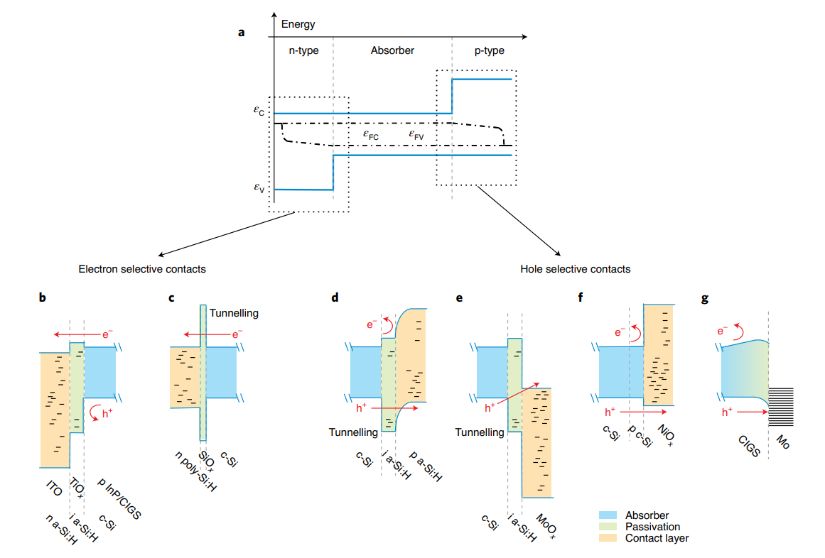
Selective contacts
Selective contacts: blocking or rejecting one of the carriers (hole or electron)

Slide 33
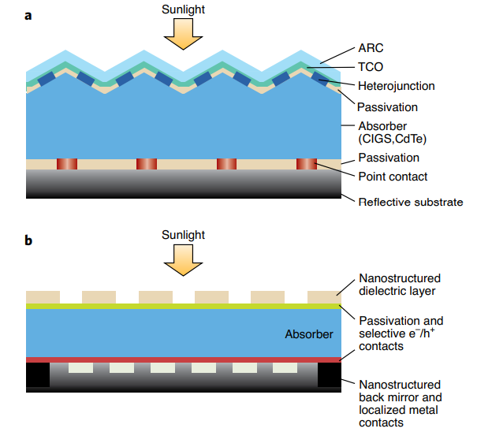
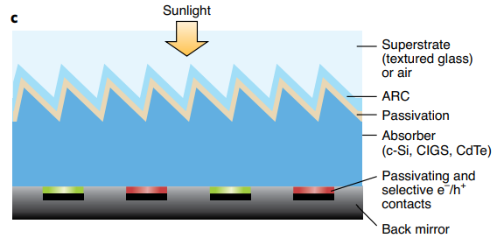
Future architectures for thin film solar cells
Single junction solar cells

Slide 34
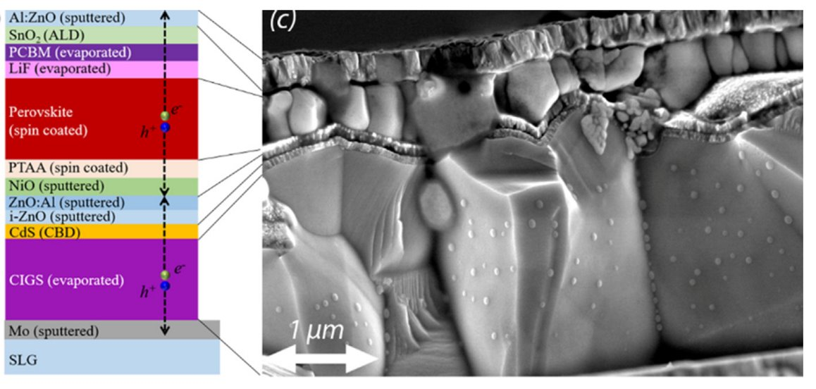
Future architectures for thin film solar cells
Tandem solar cells

Slide 35
Take-away messages
Ultrathin solar cells have many variable application
Flexible, semi-transparent, light weight
Efficiency of terrestrial thin film PV is lacking behind compared to Si wafer technology
Si: 26.7%, CIGSe: 23.35%, Perovskite: 25.7%
Efficiency improvements are implemented in two ways:
Increase the absorption
Back reflector, light scattering and anti-reflection coatings
Passivate the electron and hole contacts
Selective contacts
Tandem solar cells increase the efficiency even further
Two thin technologies, but may also be combined with Si wafer technology

Slide 36



